Slide 1
SUPERVISED LEARNING — II
K-Nearest Neighbors
The classifier that never builds a model — it just remembers
Lazy Learning
Distance-Based
Majority Vote

Slide 2
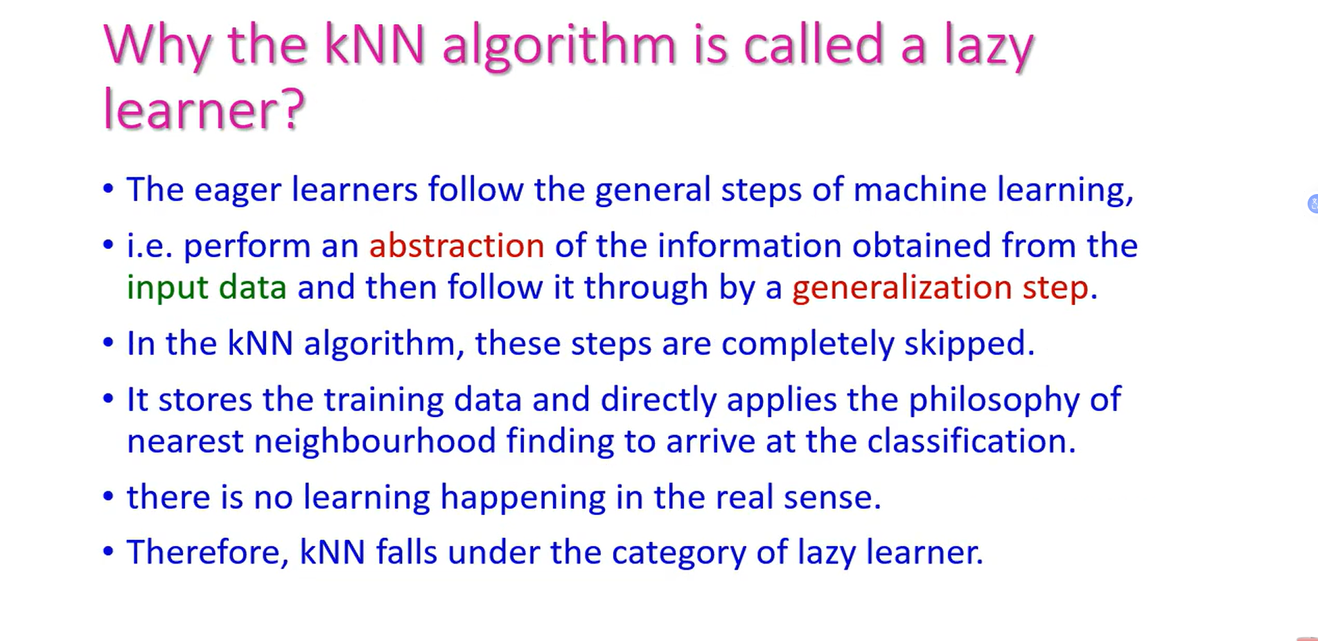

Slide 3
WHY KNN?
A different way of learning: lazy vs. eager
EAGER LEARNERS
LAZY LEARNER
ID3 · CART · Naïve Bayes
K-Nearest Neighbors
Build an explicit model during training — a tree of rules, or a set of probabilities.
Training takes time; prediction is fast — just apply the learned rule.
The model can be inspected, pruned, and reused without the original data.
Builds no model at all — it just stores the training data.
“Training” is instant; all the work happens at prediction time.
To classify a new point, it looks at which labeled points sit closest to it.
Guiding question: if you can’t build a formula or a tree, how would you guess a new point’s label using only the data you already have?

Slide 4
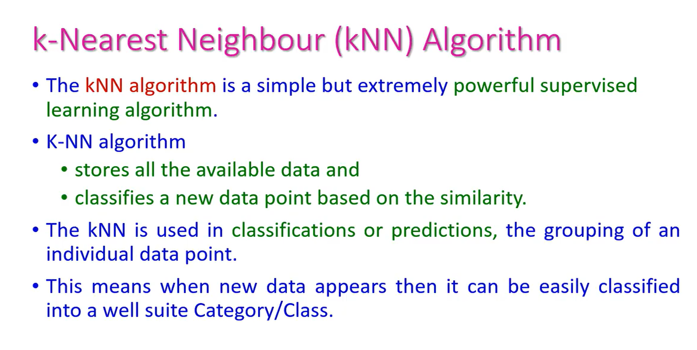

Slide 5
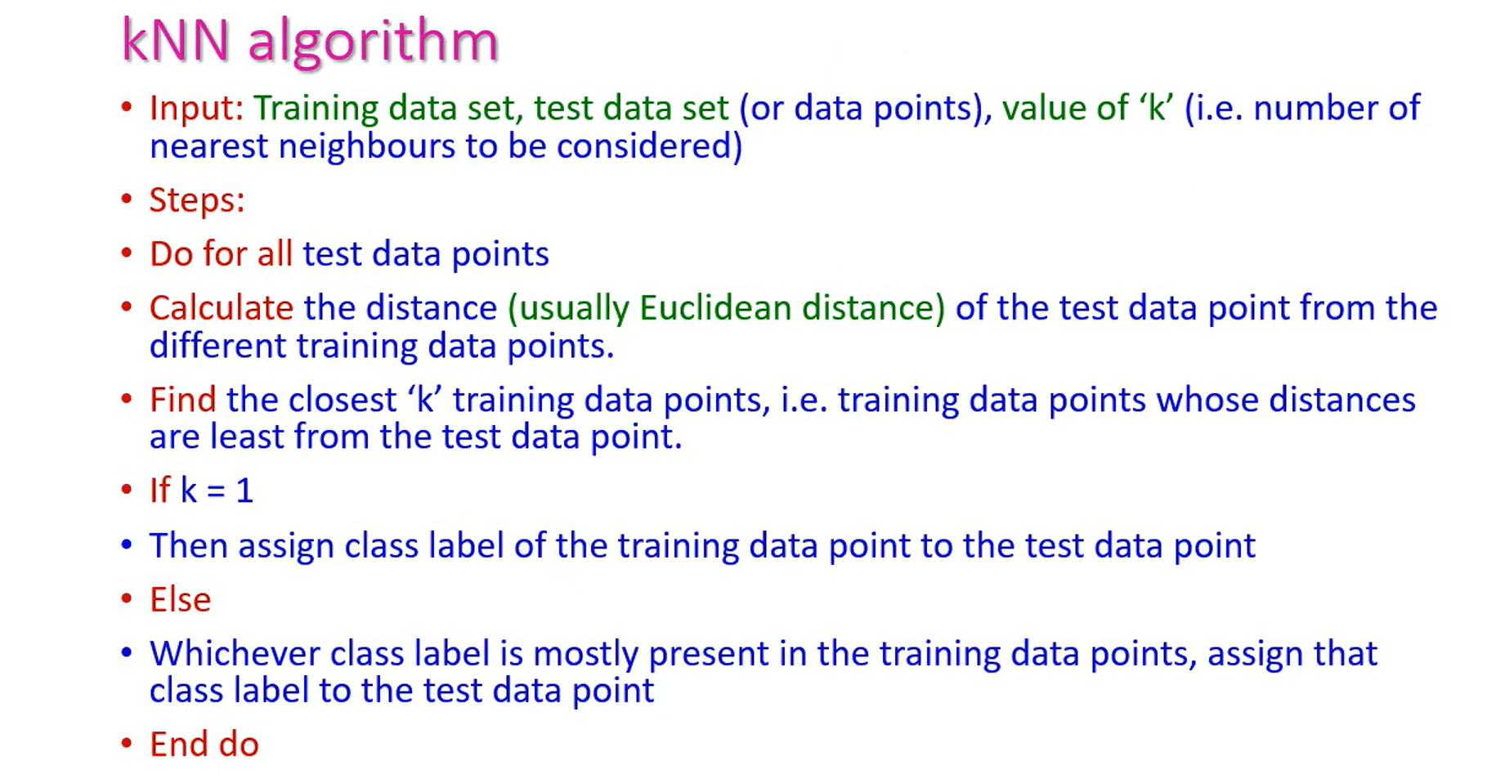

Slide 6
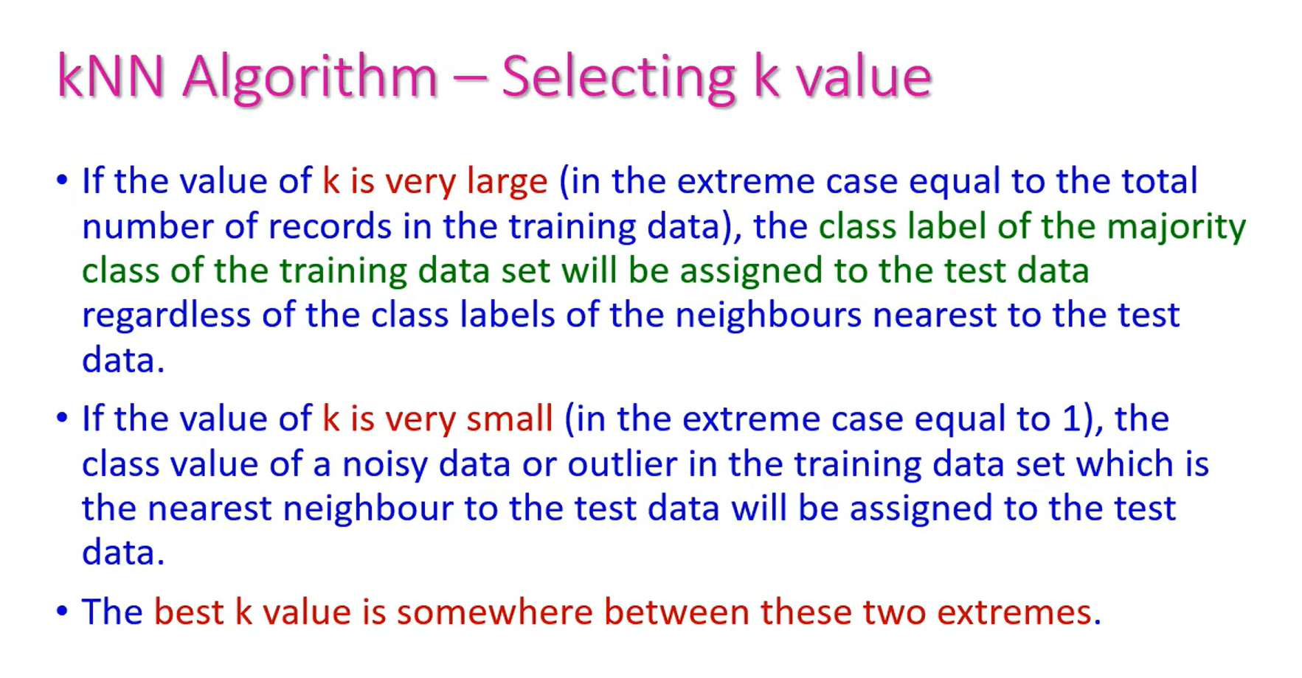

Slide 7
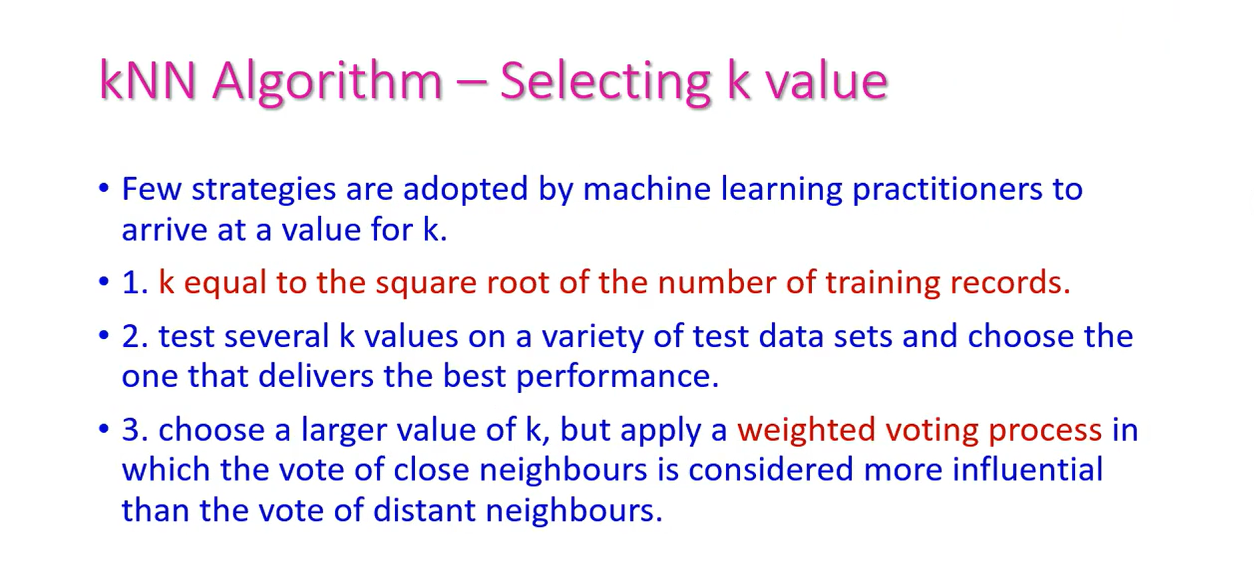

Slide 8
CHOOSING K
Choosing K is a bias–variance tradeoff
e.g. K = 1
e.g. K = n/2
tuned K
Small K
Large K
Just right
Flexible, jagged boundary. Low bias, high variance — very sensitive to noise. Easy to overfit.
Smooth boundary. High bias, low variance — may blur real local structure. Easy to underfit.
Found via cross-validation, not a formula
Practical rules: prefer an odd K to avoid tie votes • a common starting point is K ≈ √n (here, n=8 → K≈3) • sweep K and pick the value with lowest cross-validation error.

Slide 9
Classify a point by asking its neighbors
To classify a new point x, find the K training points closest to x, and assign the class that most of them belong to.
1
2
3
Store
Measure
Vote
Keep the entire labeled training set in memory. No training phase, no parameters learned.
For a new point, compute its distance to every stored point (usually Euclidean).
Take the K closest points and assign the majority class among them.

Slide 10
THE MEASURING STICK
Distance metrics: how “close” is defined
Euclidean
Manhattan
Minkowski
d(x,y) = √Σ(xᵢ − yᵢ)²
d(x,y) = Σ|xᵢ − yᵢ|
d(x,y) = (Σ|xᵢ − yᵢ|ᵖ)^(1/p)
Straight-line distance. The default choice for continuous, similarly-scaled features.
Sum of absolute differences — like navigating a city grid. Less sensitive to outliers.
A generalization: p=2 gives Euclidean, p=1 gives Manhattan.

Slide 11
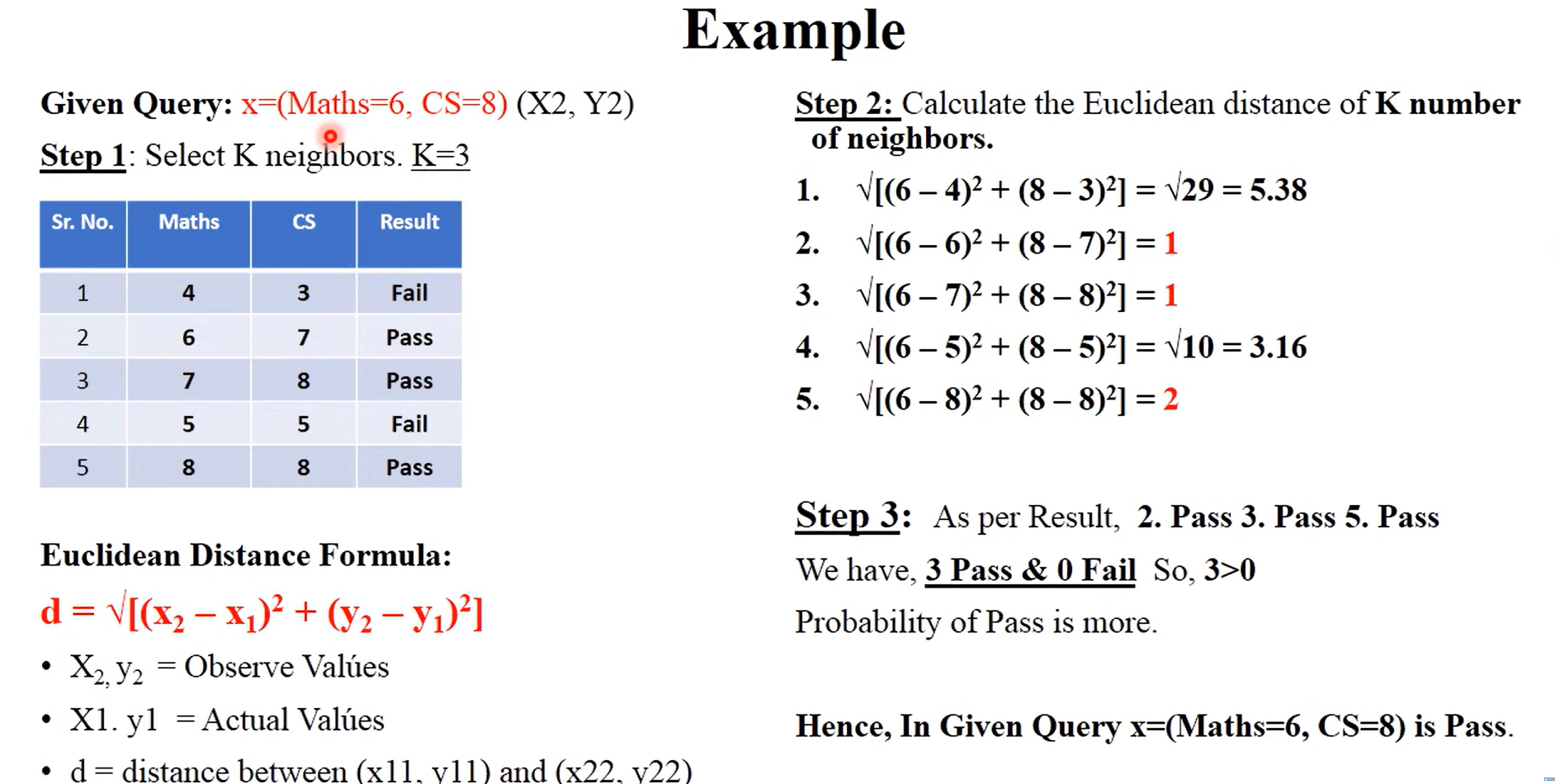

Slide 12
WORKED EXAMPLE
Will this student pass?
Y: Assignments ↑
Two features: hours studied per week (X) and assignments completed out of 10 (Y). The new student studied 5 hours and completed 5 assignments — Pass or Fail?
S7
Student | X (hrs) | Y (assign.) | Result
S1 | 6 | 6 | Pass
S2 | 3 | 5 | Pass
S3 | 5 | 2 | Fail
S4 | 8 | 3 | Fail
S5 | 1 | 4 | Fail
S6 | 6 | 0 | Fail
S7 | 10 | 8 | Fail
S8 | 11 | 3 | Pass
New? | 5 | 5 | ?
S1
S2
S5
New (5,5)
S4
S8
S3
S6
X: Hours studied →
Pass
Fail
New point

Slide 13
WORKED EXAMPLE — STEP 1
Compute the Euclidean distance to every point
d(New, Sᵢ) = √(5 − xᵢ)² + (5 − yᵢ)²
Student | X | Y | Result | Calculation | Distance
S1 | 6 | 6 | Pass | √(1²+1²) | 1.41
S2 | 3 | 5 | Pass | √(2²+0²) | 2.00
S3 | 5 | 2 | Fail | √(0²+3²) | 3.00
S4 | 8 | 3 | Fail | √(3²+2²) | 3.61
S5 | 1 | 4 | Fail | √(4²+1²) | 4.12
S6 | 6 | 0 | Fail | √(1²+5²) | 5.10
S7 | 10 | 8 | Fail | √(5²+3²) | 5.83
S8 | 11 | 3 | Pass | √(6²+2²) | 6.32

Slide 14
WORKED EXAMPLE — STEP 2
Sort by distance, then vote (K = 3)
Rank | Student | Distance | Result | In K=3?
1 | S1 | 1.41 | Pass | ✓
2 | S2 | 2.00 | Pass | ✓
3 | S3 | 3.00 | Fail | ✓
4 | S4 | 3.61 | Fail
5 | S5 | 4.12 | Fail
6 | S6 | 5.10 | Fail
7 | S7 | 5.83 | Fail
8 | S8 | 6.32 | Pass
Nearest 3 neighbors
S1 (Pass) · S2 (Pass) · S3 (Fail)
Vote: 2 Pass vs 1 Fail
→ Majority class wins
Prediction: PASS

Slide 15
THE ROLE OF K
The same point, two different answers
As K grows, the neighborhood expands — and the majority vote can flip.
K = 3
K = 7
S1 (Pass) · S2 (Pass) · S3 (Fail)
S1 (Pass) · S2 (Pass) · S3 (Fail) · S4 (Fail) · S5 (Fail) · S6 (Fail) · S7 (Fail)
Vote: 2 Pass vs 1 Fail
Vote: 2 Pass vs 5 Fail
Prediction: PASS
Prediction: FAIL

Slide 16
BEFORE YOU USE KNN
Three things that quietly break KNN
Feature scaling
Distance is dominated by whichever feature has the largest numeric range. Always standardize or normalize features first.
1
Curse of dimensionality
In high dimensions, distances stop being meaningful — all points start looking roughly equidistant.
2
Computational cost
No training cost, but every prediction compares against all N stored points. KD-trees / Ball-trees speed this up in practice.
3

Slide 17
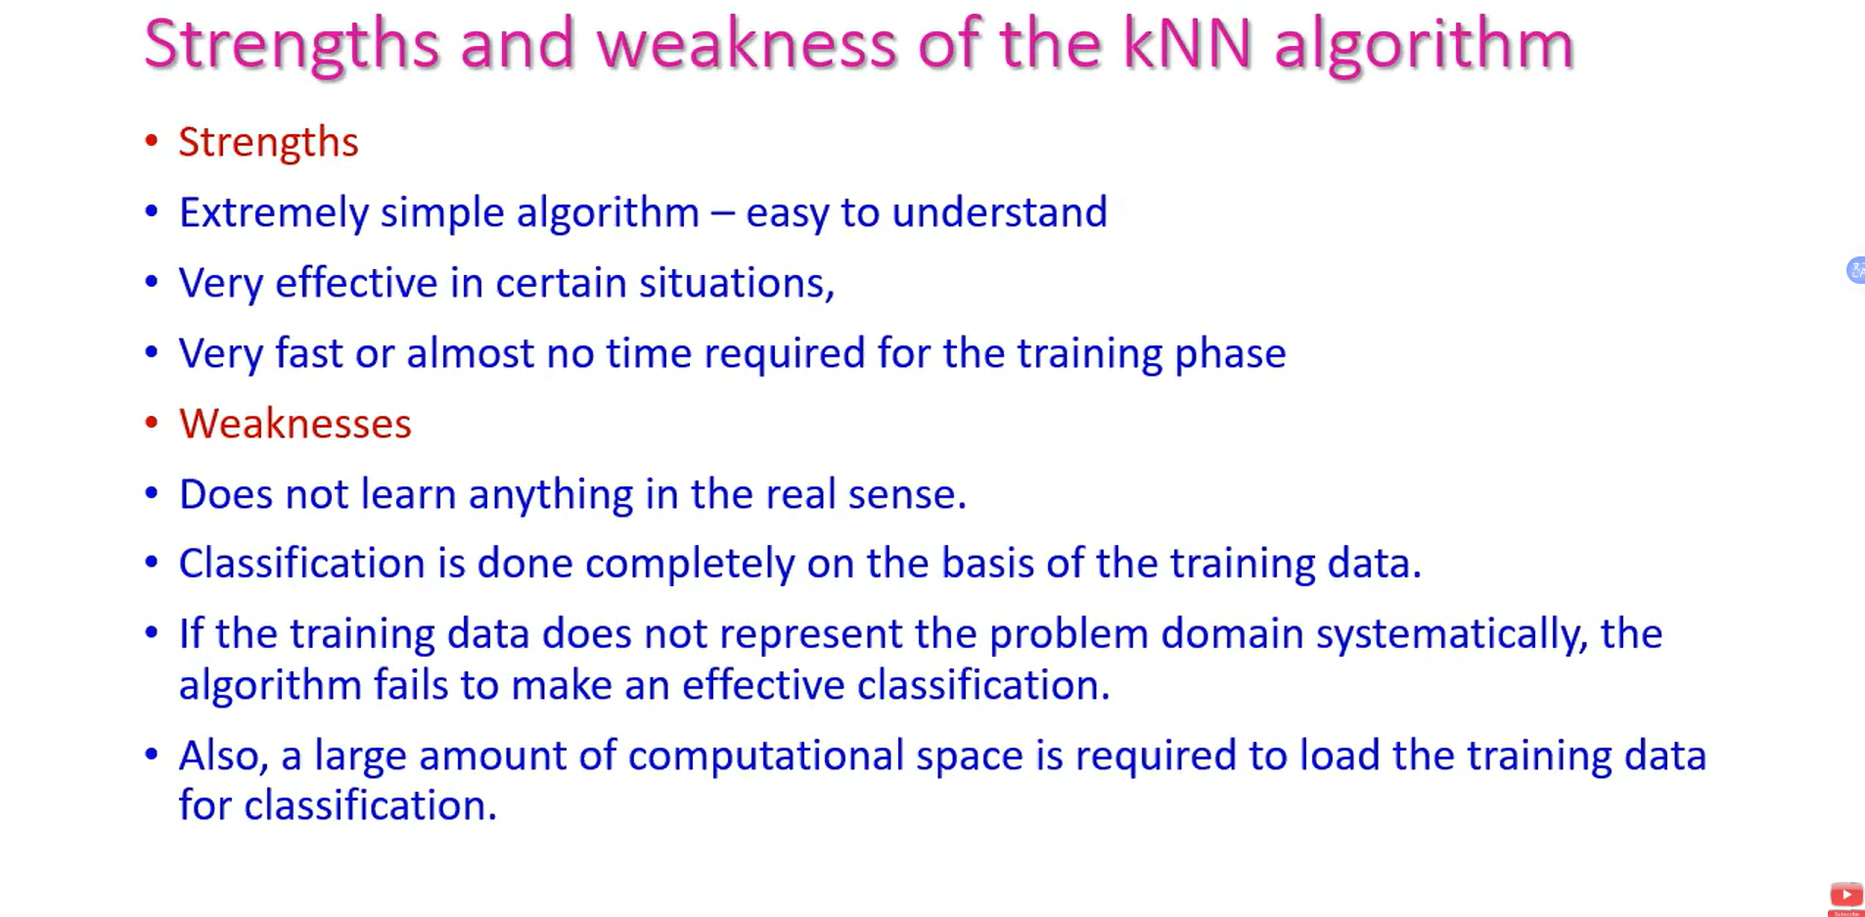

Slide 18


